Slide 1

Visualization and Analysis – Tutorial Presentation for Feedback Date: 11 / 11 / 2024
Group Id: A094 Name of Student Presenting: Lakshman Sivarathan

Slide 2
Part 1: VISUALISATION

Slide 3
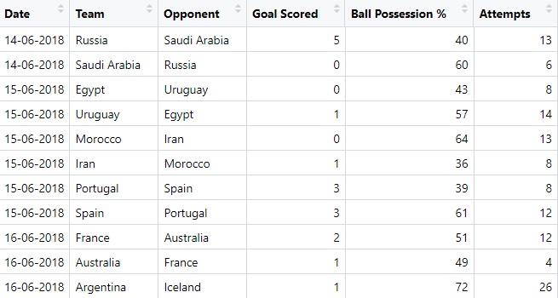
We are using the dataset DS051 and FIFA 2018 Statistics.csv to answer our Research Question “Is there a correlation between the number of goals scored and ball possession during the FIFA world cup 2018?” ¹
The dataset has 128 rows and the variables we use are Goal Scored (dependent variable³) and Ball Possession (independent variable⁴).

Slide 4
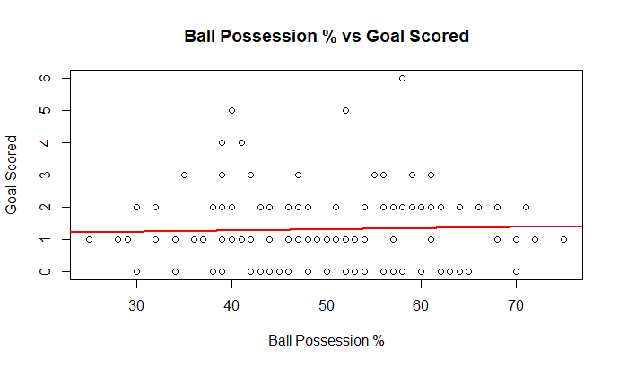
A scatterplot to include the linear trendline
Correlation related visualizations
Correlation analyses how an ordinal/interval dependent var correlates to an ordinal/interval independent variable

Slide 5
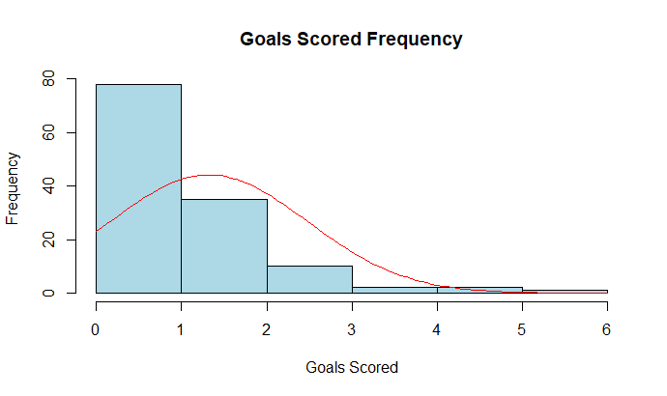
A histogram to include the normal curve overlay.
Correlation related visualizations
Correlation analyses how an ordinal/interval dependent var correlates to an ordinal/interval independent variable

Slide 6
Part 2: Analysis (building on your Visualizations)

Slide 7
Here is a Histogram showing the frequencies of our dependent variable to include the normal curve overlay.
Our RQ asks about Correlation
The normal curve overlay does not follow the shape of the underlying data, so for our analysis we use the non-parametric test for correlation that does not assume normality: Spearman’s Rho
7
Notes:
7

Slide 8
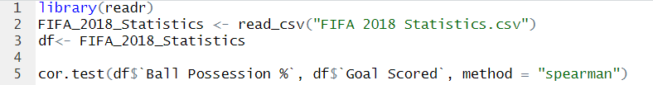
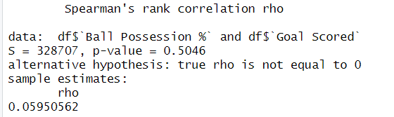
R Script and Results (For ALL types of test) – The Analysis
PRE 7COM1079-2022 Student Group No: ?????
8
Include a snippet of the R code you use to calculate your test statistic.
Give the value of the test statistic.
Tell us the p-value. Is it > or < 0.05?
In this case, p-value = 0.5046, which is much greater than 0.05.
Notes:
8

Slide 9
R Script and Results (For ALL types of test) – The Analysis
Is the result significant?
This means there is no statistically significant correlation between Ball Possession % and Goal Scored based on our data, at the 5% significance level. The observed correlation (rho = 0.0595) is not strong enough to be considered meaningful.
Do you accept or reject the null hypothesis?
Therefore, we fail to reject the null hypothesis.
What does the result actually mean in the wider context of learning something useful / answering your RQ?
This implies that there is no correlation between ball possession and goals scored based on this dataset

Slide 10
